Slide 1
2.6
Integer Data Types

Slide 2
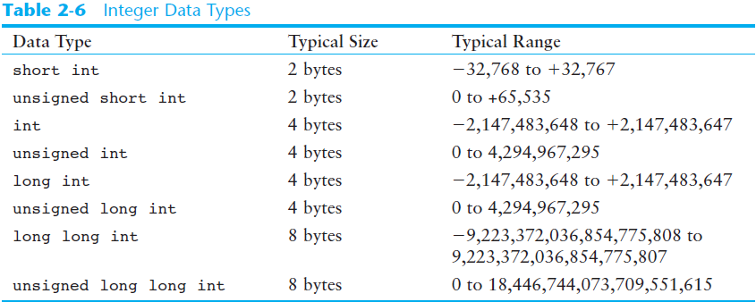

Integer Data Types
Integer variables can hold whole numbers such as 12, 7, and -99.

Slide 3
Defining Variables
Variables of the same type can be defined
  - On separate lines:
  int length;
  int width;
  unsigned int area;
  - On the same line:
  int length, width;
  unsigned int area;
Variables of different types must be in different definitions

Slide 4
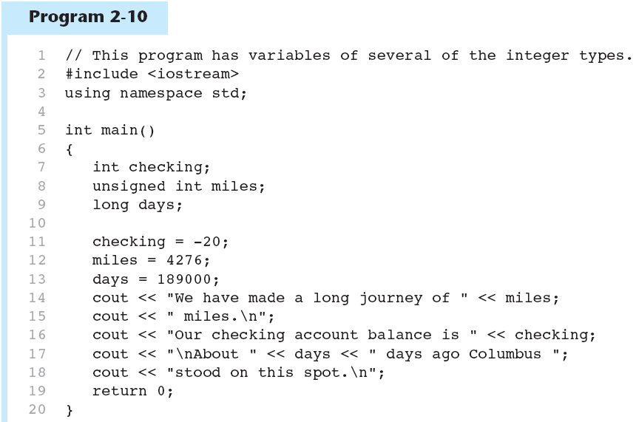
Integer Types in Program 2-10
This program has three variables:
checking, miles, and days

Slide 5
Integer Literals
An integer literal is an integer value that is typed into a program’s code. For example:
itemsOrdered = 15;
In this code, 15 is an integer literal.

Slide 6
Integer Literals in Program 2-10
Integer Literals

Slide 7
Integer Literals
Integer literals are stored in memory as ints by default
To store an integer constant in a long memory location, put ‘L’ at the end of the number: 1234L
To store an integer constant in a long long memory location, put ‘LL’ at the end of the number: 324LL
Constants that begin with ‘0’ (zero) are base 8: 075
Constants that begin with ‘0x’ are base 16: 0x75A

Slide 8
2.7
The char Data Type

Slide 9
The char Data Type
Used to hold characters or very small integer values
Usually 1 byte of memory
Numeric value of character from the character set is stored in memory:
CODE:
char letter;
letter = 'C';
MEMORY:
letter
67

Slide 10
Character Literals
Character literals must be enclosed in single quote marks. Example:
'A'

Slide 11
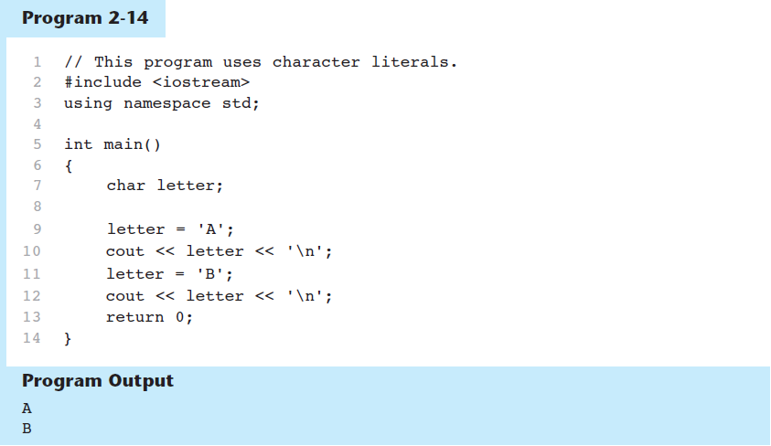
Character Literals in Program 2-14

Slide 12
Character Strings
A series of characters in consecutive memory locations:
  "Hello"
Stored with the null terminator, \0, at the end:
Comprised of the characters between the " "
H | e | l | l | o | \0

Slide 13
2.8
The C++ string Class

Slide 14
The C++ string Class
Special data type supports working with strings
#include <string>
Can define string variables in programs:
  string firstName, lastName;
Can receive values with assignment operator:
  firstName = "George";
  lastName = "Washington";
Can be displayed via cout
  cout << firstName << " " << lastName;

Slide 15
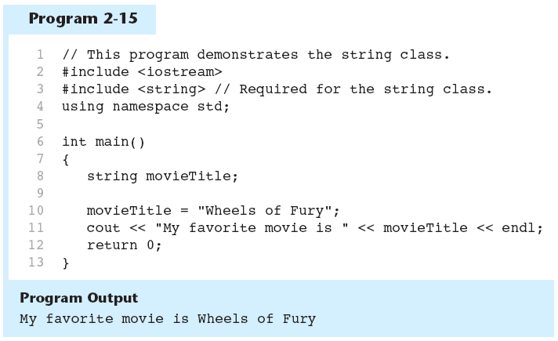
The string class in Program 2-15

Slide 16
2.9
Floating-Point Data Types

Slide 17
Floating-Point Data Types
The floating-point data types are:
float
double
long double
They can hold real numbers such as:
  12.45 -3.8
Stored in a form similar to scientific notation
All floating-point numbers are signed

Slide 18
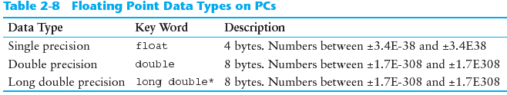
Floating-Point Data Types

Slide 19
Floating-Point Literals
Can be represented in
  Fixed point (decimal) notation:
  31.4159 0.0000625
  E notation:
  3.14159E1 6.25e-5
Are double by default
Can be forced to be float (3.14159f) or long double (0.0000625L)

Slide 20
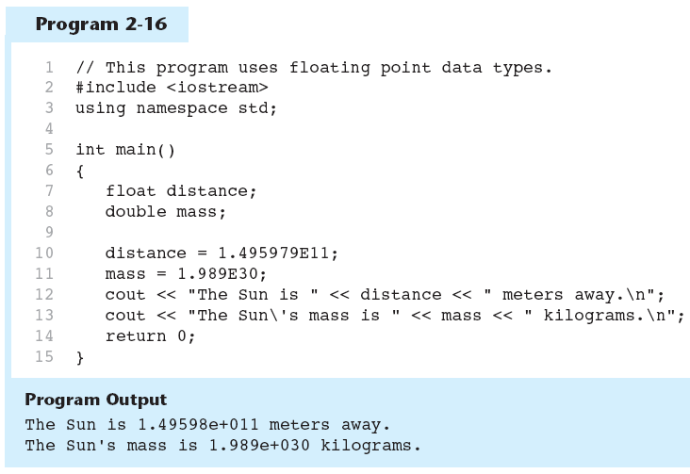
Floating-Point Data Types in Program 2-16

Slide 21
2.10
The bool Data Type

Slide 22
The bool Data Type
Represents values that are true or false
bool variables are stored as small integers
false is represented by 0, true by 1:
  bool allDone = true;
  bool finished = false;
allDone
finished
1
0

Slide 23
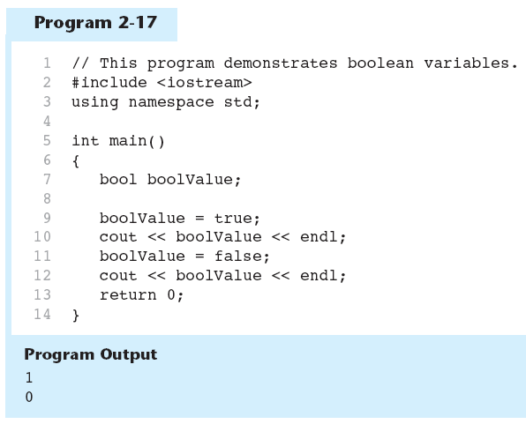
Boolean Variables in Program 2-17

Slide 24
2.11
Determining the Size of a Data Type

Slide 25
Determining the Size of a Data Type
The sizeof operator gives the size of any data type or variable:
double amount;
cout << "A double is stored in "
<< sizeof(double) << "bytes\n";
cout << "Variable amount is stored in "
<< sizeof(amount)
<< "bytes\n";

Slide 26
2.12
Variable Assignments and Initialization

Slide 27
Variable Assignments and Initialization
An assignment statement uses the = operator to store a value in a variable.
item = 12;
This statement assigns the value 12 to the item variable.

Slide 28
Assignment
The variable receiving the value must appear on the left side of the = operator.
This will NOT work:
// ERROR!
12 = item;

Slide 29
Variable Initialization
To initialize a variable means to assign it a value when it is defined:
  int length = 12;
Can initialize some or all variables:
  int length = 12, width = 5, area;

Slide 30
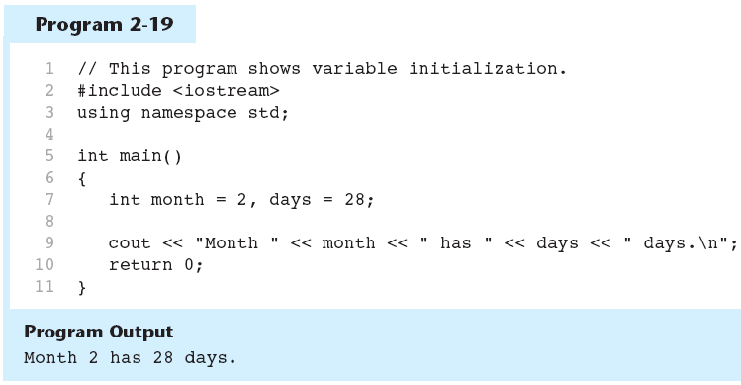
Variable Initialization in Program 2-19

Slide 31
Declaring Variables With the auto Key Word
C++ 11 introduces an alternative way to define variables, using the auto key word and an initialization value. Here is an example:
auto amount = 100;
The auto key word tells the compiler to determine the variable’s data type from the initialization value.
auto interestRate= 12.0;
auto stockCode = 'D';
auto customerNum = 459L;
int
double
char
long

Slide 32
2.13
Scope

Slide 33
Scope
The scope of a variable: the part of the program in which the variable can be accessed
A variable cannot be used before it is defined

Slide 34
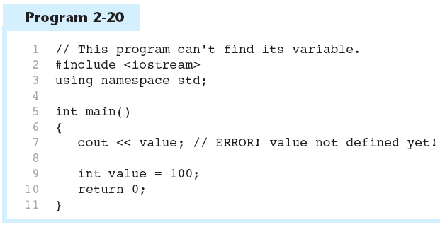
Variable Out of Scope in Program 2-20

Slide 35
2.14
Arithmetic Operators

Slide 36
Arithmetic Operators
Used for performing numeric calculations
C++ has unary, binary, and ternary operators:
  unary (1 operand) -5
  binary (2 operands) 13 - 7
  ternary (3 operands) exp1 ? exp2 : exp3

Slide 37
Binary Arithmetic Operators
SYMBOL | OPERATION | EXAMPLE | VALUE OF ans
+ | addition | ans = 7 + 3; | 10
- | subtraction | ans = 7 - 3; | 4
* | multiplication | ans = 7 * 3; | 21
/ | division | ans = 7 / 3; | 2
% | modulus | ans = 7 % 3; | 1

Slide 38
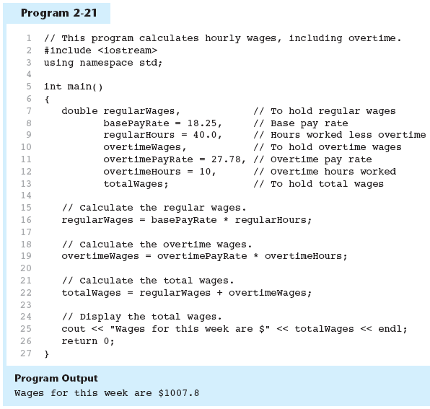
Arithmetic Operators in Program 2-21

Slide 39
A Closer Look at the / Operator
/ (division) operator performs integer division if both operands are integers
  cout << 13 / 5; // displays 2
  cout << 91 / 7; // displays 13
If either operand is floating point, the result is floating point
  cout << 13 / 5.0; // displays 2.6
  cout << 91.0 / 7; // displays 13.0

Slide 40
A Closer Look at the % Operator
% (modulus) operator computes the remainder resulting from integer division
  cout << 13 % 5; // displays 3
% requires integers for both operands
  cout << 13 % 5.0; // error

Slide 41
2.15
Comments

Slide 42
Comments
Used to document parts of the program
Intended for persons reading the source code of the program:
  Indicate the purpose of the program
  Describe the use of variables
  Explain complex sections of code
Are ignored by the compiler

Slide 43
Single-Line Comments
Begin with // through to the end of line:
  int length = 12; // length in inches
  int width = 15; // width in inches
  int area; // calculated area
  // calculate rectangle area
  area = length * width;

Slide 44
Multi-Line Comments
Begin with /*, end with */
Can span multiple lines:
  /* this is a multi-line
  comment
  */
Can begin and end on the same line:
  int area; /* calculated area */

Slide 45
2.16
Named Constants

Slide 46
Named Constants
Named constant (constant variable): variable whose content cannot be changed during program execution
Used for representing constant values with descriptive names:
  const double TAX_RATE = 0.0675;
  const int NUM_STATES = 50;
Often named in uppercase letters

Slide 47
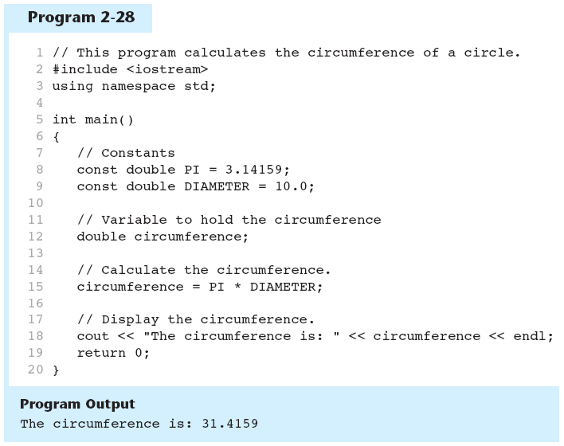
Named Constants in Program 2-28

Slide 48
2.17
Programming Style

Slide 49
Programming Style
The visual organization of the source code
Includes the use of spaces, tabs, and blank lines
Does not affect the syntax of the program
Affects the readability of the source code

Slide 50
Arrays
An array is a collection of data
An array has a name and a data type
The name is used to refer to the collection
The data type is what the array is a collection of.

Slide 51
Arrays
Declaring an array
  int numbers[10];
In the above declaration, int is the type of data, numbers is the name of the array, and 10 is the number of integers in the collection (also called the size declarator)
Accessing an element of an array
  numbers[0] = 42;
  cout << numbers[0]

Slide 52
Arrays
Arrays are accessed using the index of the element
Arrays are 0-based indexed
A 10 element array would have indices numbers 0 to 9

